Slide 1




Collective Classification Algorithms in Identifying Intrinsically Disordered Proteins within Protein-Protein Interaction Networks
2nd ML4NGP MEETING ON MACHINE LEARNING AND NON-GLOBULAR PROTEINS
May 14 - 17, 2024 – Thessaloniki, Greece
Milana Grbić¹, Nenad Vilendečić ¹, Milan Predojević ¹, & Dragan Matić¹
¹Faculty of Natural Science and Mathematics, University of Banja Luka

Slide 2
Introduction
Traditional methods used for IDP classification?
Integrating data from PPI networks?
In this research?

Slide 3
Data, Tools, & Resources
The data used in this study pertain to the model organism S. cerevisiae - yeast.
The Protein-Protein Interaction (PPI) network – BioGRID,
IDPs from the DisProt database,
Gene expression information obtained by SPELL engine,
Protein sequences,
For data extraction and classification the following tools and resources were used:
Node2vec+ tool – for extraction of features from weighted network, based on random walks,
SMOTEEN – for sampling training set,
MinMaxScaler – for normalization of dataset,
GridSearchCV – for tuning hyperparametars of KNN.

Slide 4
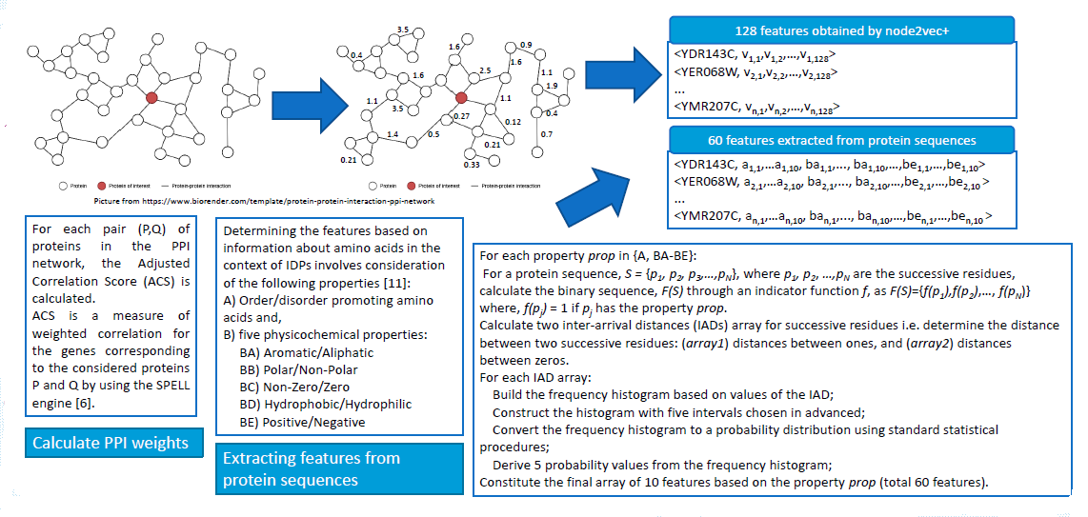
Methodology - Data preparation

Slide 5
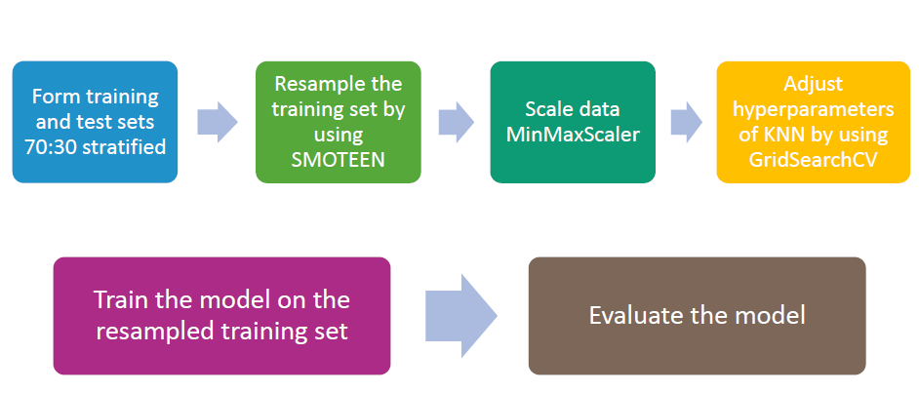
Methodology - Data classification

Slide 6
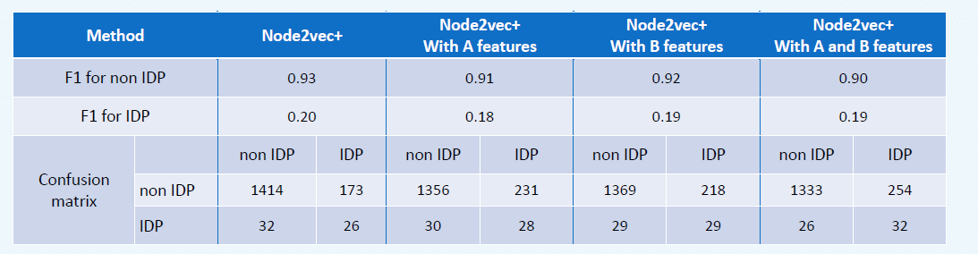
Results

Slide 7
Thank you!
Conclusion?
Future work?
Poster session I → Poster F05!

